Slide 1
Tech Innovations to Support NGO Operations
Team Members
AFEEF AHMED SHAIK
(RA2311026050166)
Mentor Details
Suganya Suchithrra

Slide 2
Contents
Problem Statement
Details of NGO visited (Name, Address, DARPAN ID)
Thematic Area and its mapping to SDG
Proposed Engineering Solution
Non-profit alignment
Proposed Milestones and Timelines
Expected Deliverables (Prototypes, Reports, Designs, Viable Solutions)
Plans to Assess the Impact
Proposed Budget
Conclusion

Slide 3
Problem Statement
The NGO staff struggled with spending hours manually entering payment info, which was slow and full of mistakes—we built a billing app that does this automatically to save time and reduce errors.
People didn’t have an easy way to understand or share the NGO’s mission, so we created a clear, inspiring website about their work for a healthier, chemical-free future.
The NGO wanted more people across the country to join their cause, so we made a second website to encourage and connect communities nationwide.
Because payment records were scattered and hard to access, we organized everything into one place so the whole team can easily find what they need.
Tracking payments in the field was difficult and confusing—we solved this by making sure every payment photo is saved with its location and neatly organized for quick reference.

Slide 4
Details of the NGO
Organization details:
Name of the Organization: Watershed Support Services and Activities Network (WASSAN)
DARPAN ID: AP/2016/0107413, Reg No: 143/118/IV/2021
Website of the NGO: https://www.wassan.org
Contact Details:
Name: MV Ramachandrudu
Email ID: wassanmail@gmail.com

Slide 5
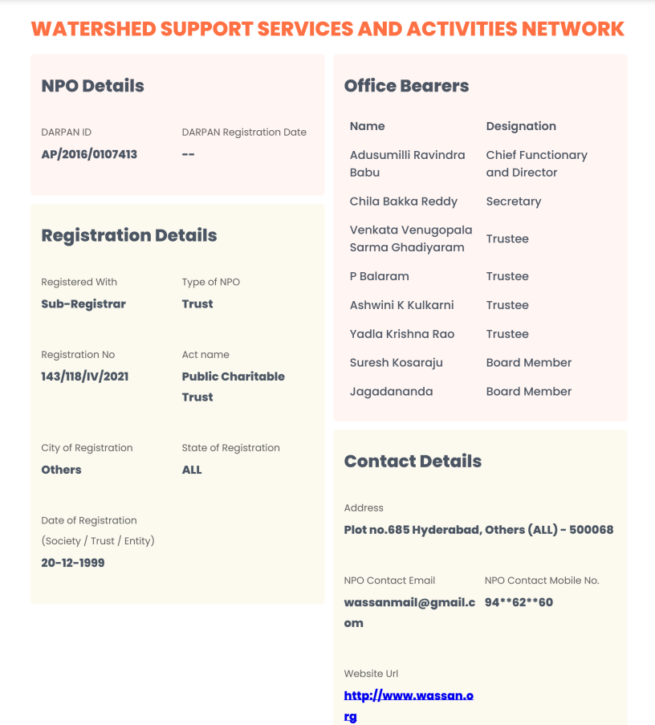
Details of the NGO

Slide 6
Thematic Area
Technology for Social Impact / Digital Solutions for NGO Development
Alignment with SDGs :
Relevant Sustainable Development Goals (SDGs):
SDG 9: Industry, Innovation, and Infrastructure Promoting inclusive and sustainable industrialization through digital tools and innovation.
SDG 11: Sustainable Cities and Communities Supporting community engagement and sustainable development through websites promoting environmental consciousness and participation.
SDG 17: Partnerships for the Goals Enhancing collaboration and data sharing within NGO teams and stakeholders via centralized, accessible digital platforms.
Justification: The NGO struggled with slow and error-prone payment tracking, which we solved by developing an app to automate the process. We also built two websites—one to promote sustainable, chemical-free living and the organization’s mission, and another to encourage and connect community participation nationwide. By organizing payment records for easy access and enabling better tracking with location-tagged photos, these solutions made the NGO’s operations more efficient, transparent, and connected.

Slide 7
Proposed Engineering Solution
A low-cost, user-friendly digital system designed for adaptability and easy adoption by NGOs, focusing on automating financial tracking, expanding outreach, and centralizing records for operational efficiency.
Technical Modules to be Implemented
Automated Billing & Payment Capture Module
Allows users to upload payment screenshots.
Uses OCR (Optical Character Recognition) to extract payment amounts and dates automatically.
Data is updated in a central, shared Excel sheet and photos are organized for quick reference.
NGO Mission Website
Public-facing website to communicate the NGO’s mission of sustainable, chemical-free living and environmental awareness.
Includes informational content, impact stories, and resources to educate and engage the public.
Community Engagement Platform
Second website designed to encourage community involvement and participation in positive change nationwide.
Features sign-ups, event information, and sharing of local initiatives.
Centralized Records Management System
Combines all payment records, documents, and reports in a single accessible location for staff, management, and volunteers.
Supports access control and easy data retrieval.

Slide 8
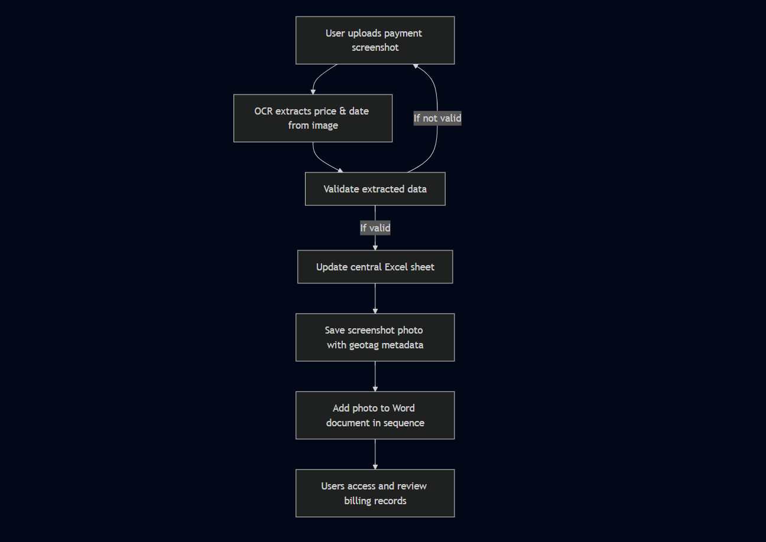
Proposed Engineering Solution
FLOWCHART-

Slide 9
Non-Profit Alignment
Needs of the Non-Profit Organization (NGO)
The proposed digital solutions are closely aligned with the NGO’s mission of fostering sustainable communities and expanding participation in environmental and social initiatives.
Identified Needs:
Time-consuming and error-prone manual payment tracking and documentation.
Limited digital presence to communicate the NGO’s mission and efforts.
Difficulty engaging and connecting with a wider community nationwide.
Scattered and inaccessible payment records, making field and audit work inefficient.
What is the relationship with community work and the NGO and Stage of the relationship with the NGO (Initial Design/ Testing/ Deployment/ Impact assessment)
Current Relationship Status:
Initial assessment: Done.
Prototype design: Functional prototypes of the billing app and websites have been created and refined based on staff and volunteer input.
Deployment: Deployment is planned at the NGO office and soon will be in reach to the staff and public
Impact Assessment:
Next stages will involve collecting feedback on time saved, error reduction, and increased engagement to measure the solutions’ effectiveness and guide further improvements.

Slide 10
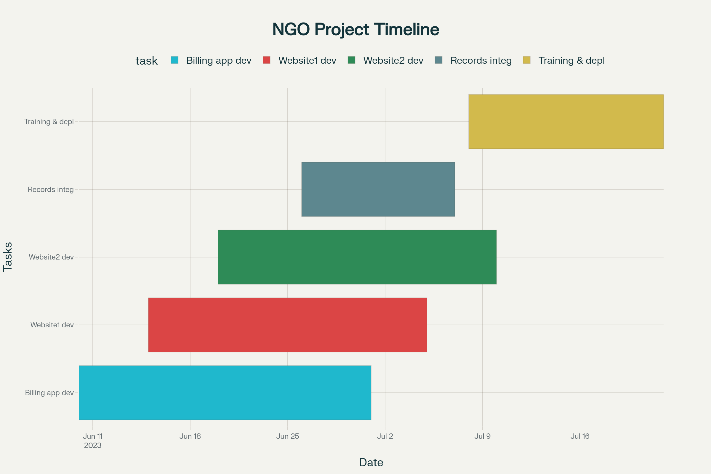
Proposed Milestones and Timelines

Slide 11
Expected Deliverables
Use of Multimedia Tools:
Designed infographics and visual summaries to explain the billing app process and website features.
Captured and integrated geo-tagged payment photos from field staff, demonstrating transparency and coverage.
Included documented user stories and testimonial quotes from NGO team members and volunteers about the impact of the new system.
Technological Solution:
Developed an automated billing web application that extracts payment details from uploaded screenshots using OCR and centralizes records.
Built two websites: one promoting the NGO’s mission of sustainable, chemical-free living, and another to increase community engagement and participation.
Optimized all solutions for ease of use and minimal training, with simple interfaces accessible from various devices.
The system is scalable, cost-effective, securely stores data, and supports remote collaboration—making it practical and sustainable for NGO operations.

Slide 12
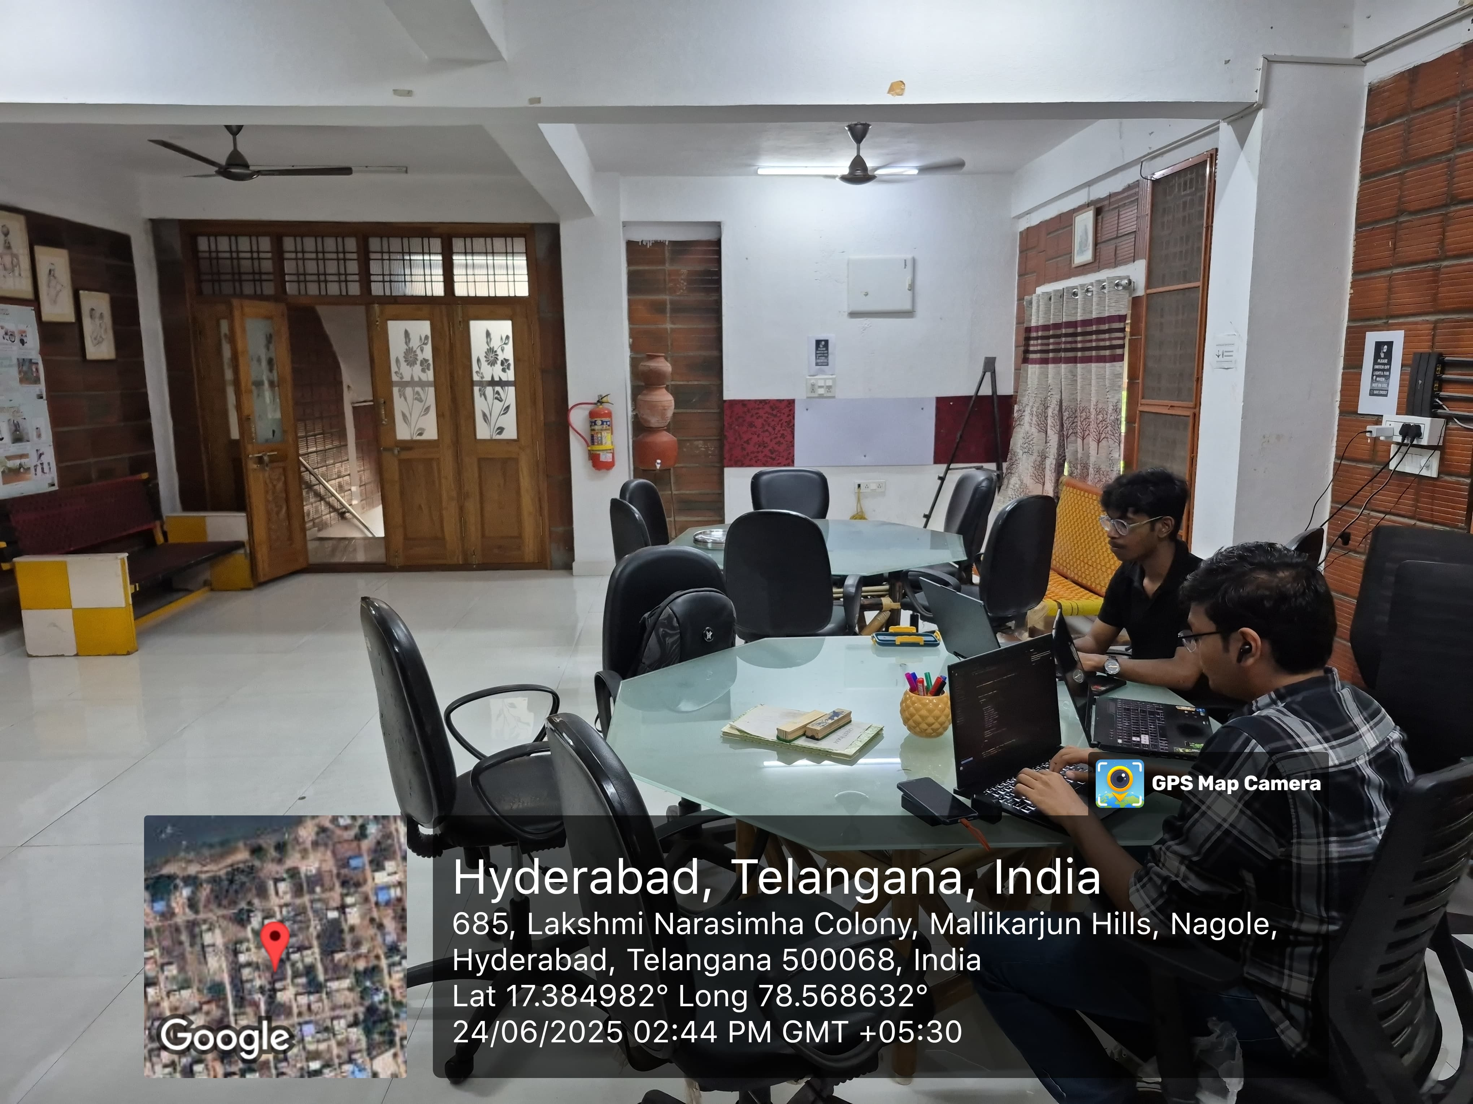
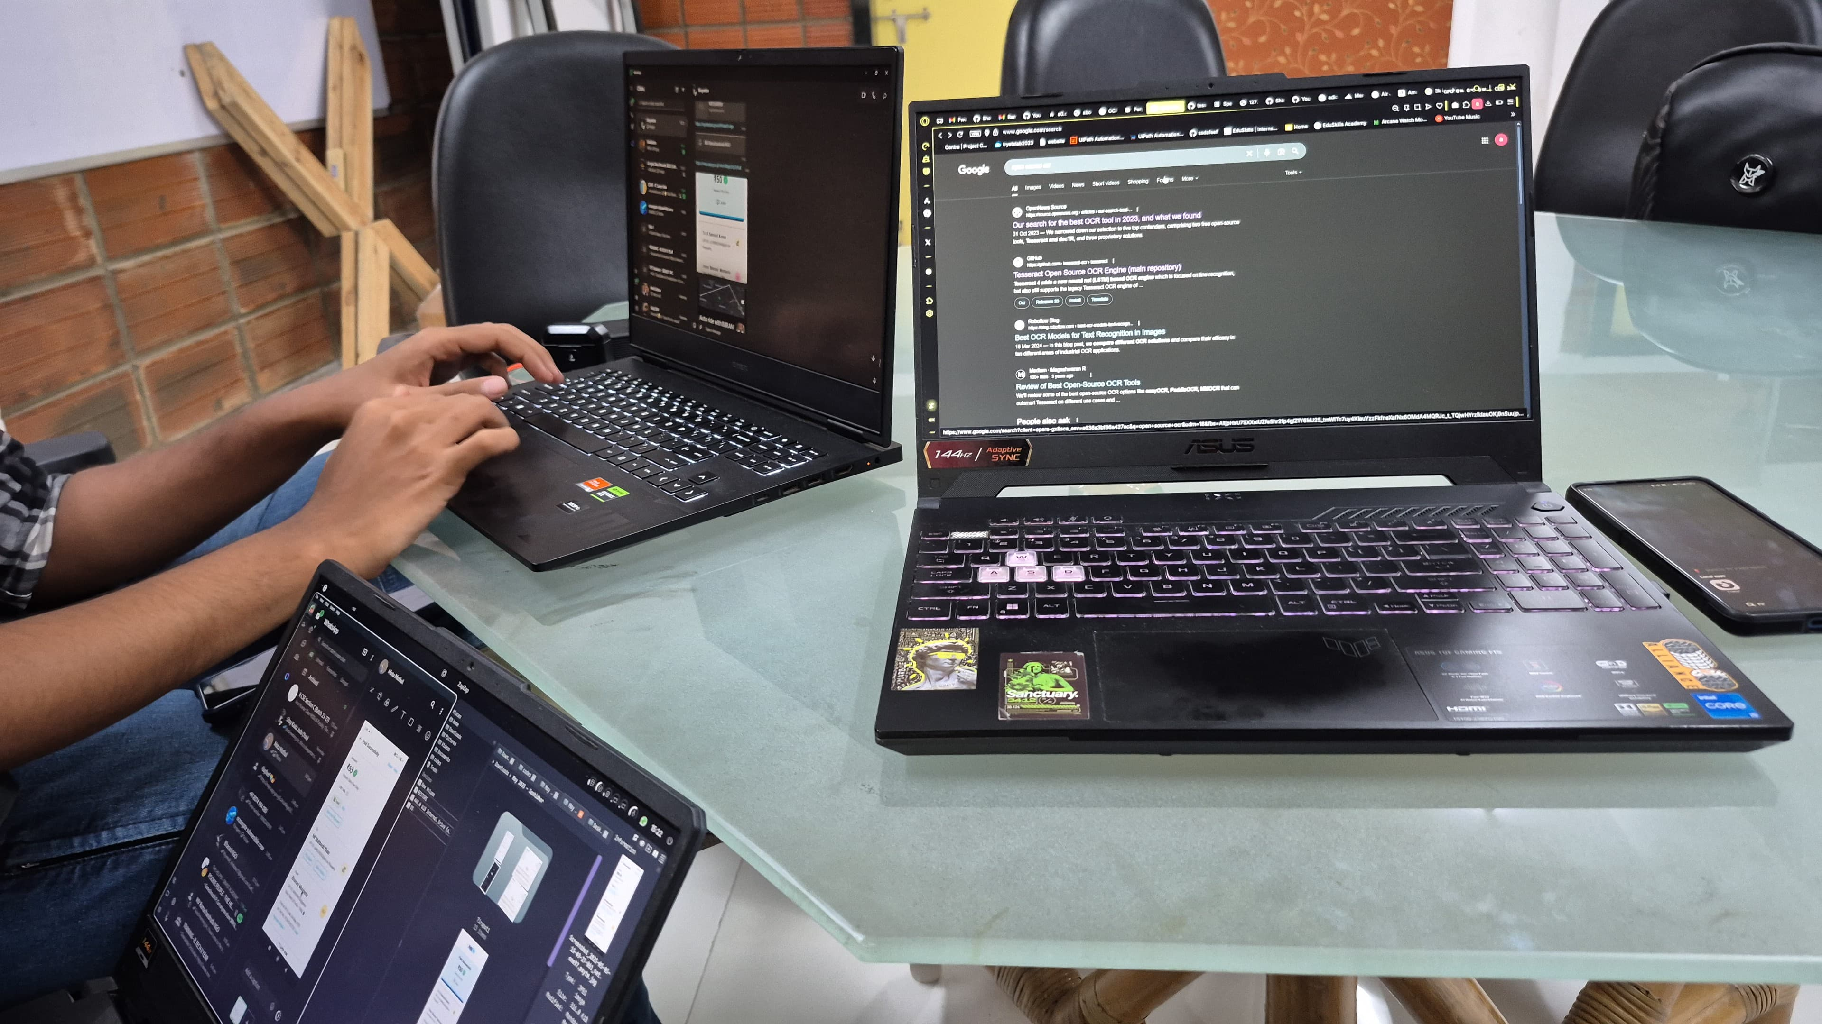
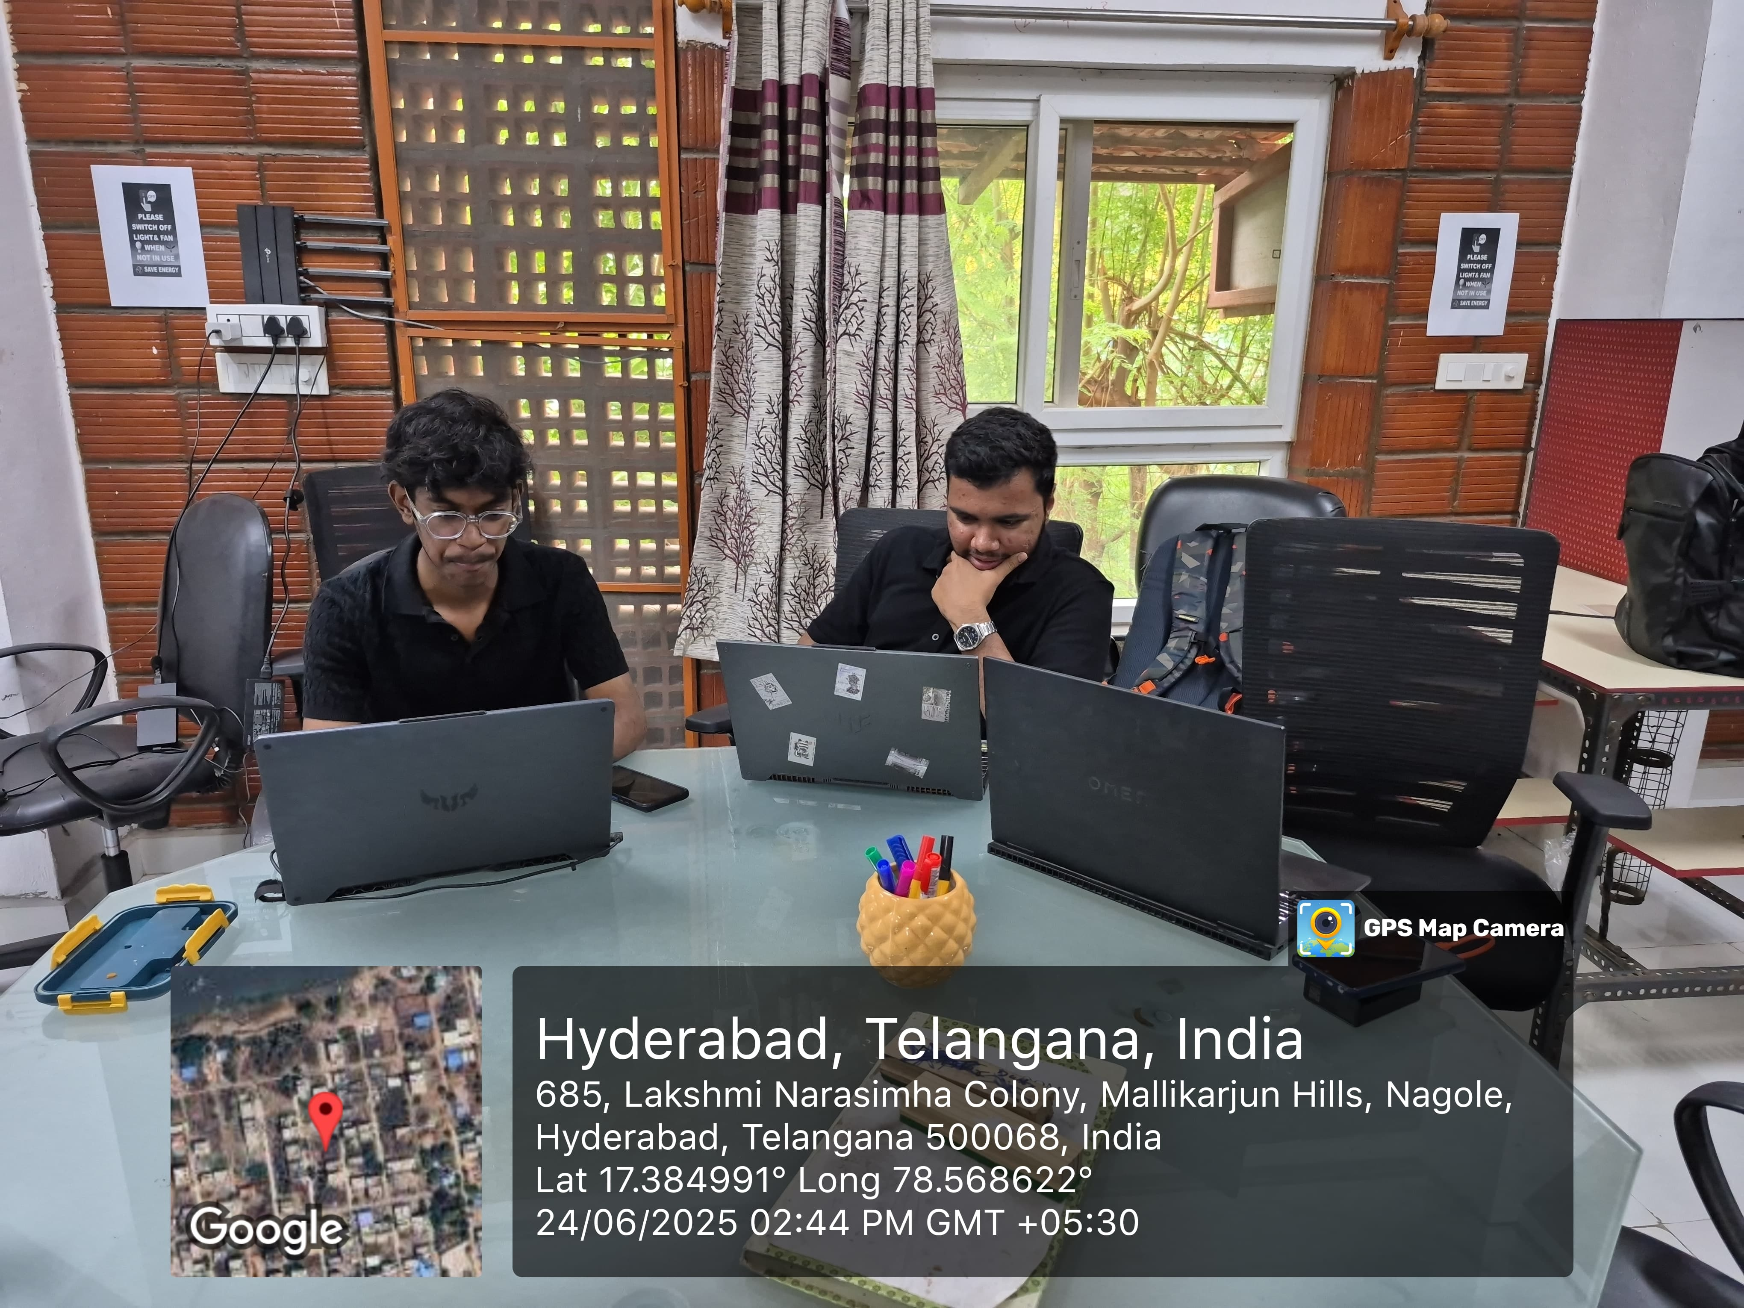
Expected Deliverables

Slide 13
Expected plan to Assess the Impact
Plan to Monitor the Solution’s Impact Over Time:
Track system usage data: Monitor how often the billing app is used, the number of payment entries automated, and the frequency of data accessed by staff and volunteers.
Collect user feedback: Hold regular feedback sessions with NGO staff, volunteers, and finance team members to gather input on usability, time savings, and workflow improvements.
Maintain observation logs: Note improvements in payment record accuracy, time saved on manual entry, and the ease of sharing information among team members.
Designing the Control Group:
Intervention Group: NGO staff and volunteers using the new billing app and websites for payment management and outreach.
Control Group: A similar NGO team or branch that continues with manual payment tracking and has not adopted the new digital tools.
Impact Metrics: Compare data entry speed, record accuracy, staff satisfaction, public engagement through the websites, and the number of new community sign-ups.

Slide 14
Expected plan to Assess the Impact
Short-Term / Immediate Impact (Within 1 Year):
More than 12 team members report faster, more accurate payment processing and easier record-keeping.
Scattered records consolidated for easy access, reducing time spent on paperwork.
Increased website traffic and interaction, helping to raise awareness for the NGO’s mission and boost community engagement.
Staff and volunteer feedback show less stress from repetitive tasks and more time freed for core outreach work.
Long-Term Impact (Within 3 Years)
System expanded to other branches or partner NGOs, improving workflow for dozens more teams.
Over 200 payment transactions processed automatically, with error rates drastically reduced.
Greater online engagement with more people joining or supporting the NGO via the websites.
Model replicable for other NGOs seeking digital transformation, enhancing transparency and efficiency in the sector.

Slide 15
Proposed Budget
Sl.No. | Equipment/Facilities | Qty. | Total (in Rs.) | Justification
 | Domain Name and Website Hosting | 1(yr) | 1500 | Registering domain names for both websites and paying for one year of basic web hosting for each.
 | Software and Online Tools | 1(yr) | 900 | Paid online tools/services that support OCR, form handling, or integration
 | Printing/Training Materials | 1(yr) | 200 | Printing visual guides or handouts for staff/volunteer training sessions.
 | Contingency/Emergency | 1(yr) | 300 | Extra buffer for unexpected small expenses (eg: platform fees, troubleshooting).
 |  | Grand Total | 2900

Slide 16
Concluding Remarks (Further directions)
Scalability: The digital solutions—automated billing app and outreach websites—can be easily replicated and adapted across 10+ NGOs or community initiatives using an open-source model, multiplying their impact.
Tech Advancements: Future upgrades could include advanced data analytics for financial trends, chatbot-based support for payment queries, and multilingual interfaces to serve diverse regional teams.
Policy Advocacy: By documenting operational improvements and community engagement outcomes, the NGO can advocate for broader adoption of digital tools in the nonprofit sector and seek partnerships or integration with national programs supporting transparent and efficient NGO operations.

